Slide 1
Attracting and retaining contributors
Asheesh Laroia
Scalathon 2011
asheesh@asheesh.org

Slide 2
Part 0.
Me, you, and this talk

Slide 3
→

Slide 4


Slide 5


paulproteus on
asheesh@
asheesh.org

Slide 6
Why I care

Slide 7
Part I.
Attracting contributors

Slide 8
<1.1>
There are people out there

Slide 9
Pop quiz

Slide 10
“My involvement with open source is primarily composed of unabashed admiration and adulation.”

Slide 11


Slide 12
Goal: attract at least one contributor every 3 months

Slide 13


Slide 14
invited

Slide 15
clear and urgent

Slide 16
offer help

Slide 17


Slide 18


Slide 19


Slide 20
This only works if you care

Slide 21
<1.2>
Focus on a few people at a time

Slide 22
Documentation is...
okay

Slide 23
Documentation is...
okay

Slide 24
Helping people and chatting is...
better

Slide 25
Helping people and chatting is...
better

Slide 26
Creating relationships is...
best

Slide 27
Creating relationships is...
best

Slide 28
Do:
Tell people
what to do

Slide 29
I want to help with Python in Debian

Slide 30
I want to help with Python in Debian
  Looka here: http://wiki.debian.org/Teams/ PythonModulesTeam

Slide 31
I want to help with Python in Debian
  Looka here: http://wiki.debian.org/Teams/ PythonModulesTeam
    I’ve already seen that page but didn’t find any specific tasks.

Slide 32
(then I told Andrey to work on expo.debian.net)

Slide 33
<1.3>
How to get people to show up

Slide 34
Walk around
and ask

Slide 35
Ask for: code help

Slide 36
Ask for: mailing list and IRC participants

Slide 37
Be human

Slide 38
“You can file a bug at...”
vs.
“I will send you a postcard if you file a bug”

Slide 39
Advertise to users

Slide 40
<1.4>
Run events

Slide 41
Build It

Slide 42
GIMP:
1 attendee

Slide 43
Vidalia:
8 attendees

Slide 44
Debian:
26 attendees

Slide 45
“I... never really knew where to begin...
It’s nice to have somewhere to turn when you are struggling with something 'simple'.”

Slide 46
Part II.
Retaining contributors

Slide 47
<2.1>
“Thank you” is a renewable resource

Slide 48
Be specific

Slide 49
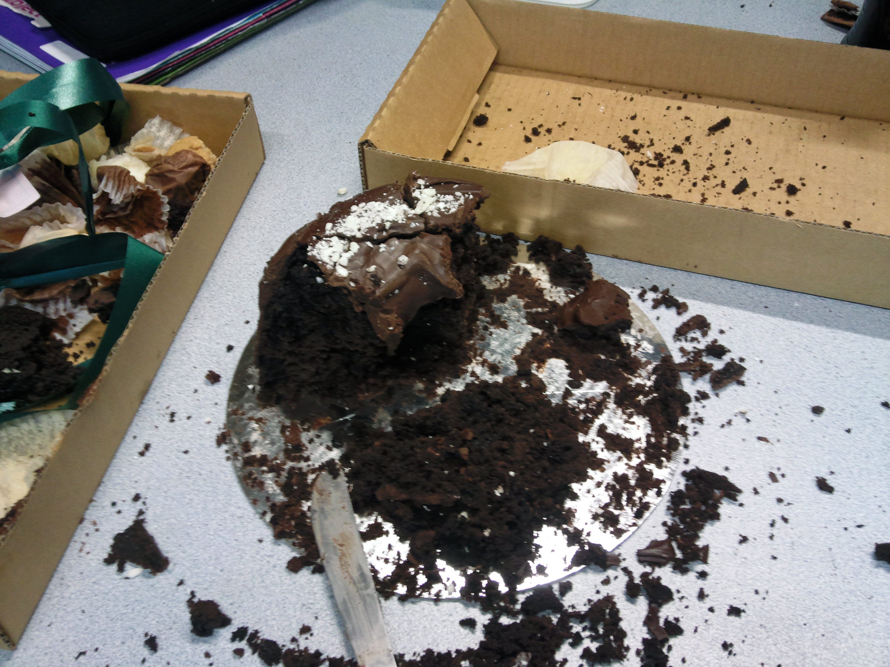

Slide 50
<2.2>
Tap into people's motivations

Slide 51
Do they want to learn?

Slide 52
Do they want to
work on software that is widely-used?

Slide 53
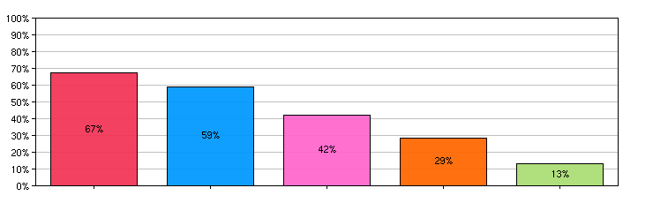
Helping millions of people | 67%
Helping further the Mozilla mission | 59%
Being able to solve problems for me or my organization | 42%
Being part of the Thunderbird team | 29%
Other | 13%

Slide 54
<2.3>
Don't let them forget you

Slide 55
“Send an email to devel@
lists.openhatch.org granting us permission to use your work”

Slide 56
<2.4>
How to make it not suck

Slide 57
Paperwork sucks

Slide 58
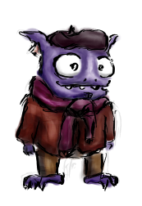

Slide 59
Broken builds suck

Slide 60
Closed communities suck

Slide 61
Being stuck sucks

Slide 62
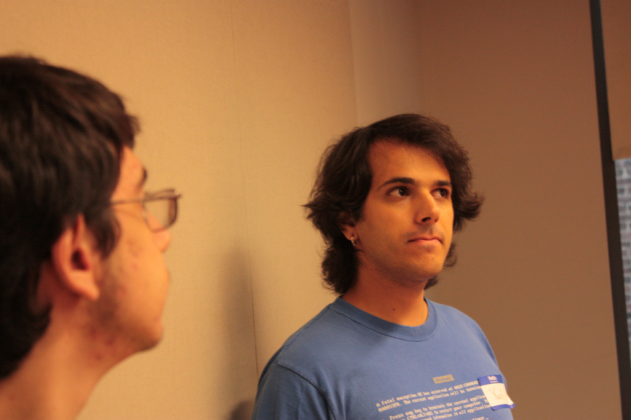

Slide 63
<2.5>
Unhappy communities suck

Slide 64
Do:
Decrease latency
(and terror)

Slide 65
for shy
people

Slide 66
-mentors

Slide 67
-mentors
Sep 2010
280 messages
26 unanswered

Slide 68
-mentors
Oct 2010
“Four days” goal

Slide 69
-mentors
Nov 2010
600 messages
3 unanswered

Slide 70
-mentors
Dec 2010
500 messages
7 unanswered

Slide 71
-mentors
“Four days” project
Messages +200%
Unanswered -90%

Slide 72
It “just” takes work

Slide 73
EOF

Slide 74
Attracting and retaining contributors
Asheesh Laroia
Scalathon 2011
asheesh@asheesh.org
http://openhatch.org/

